Slide 1
British Airways
Prediction model booking completed

Slide 2
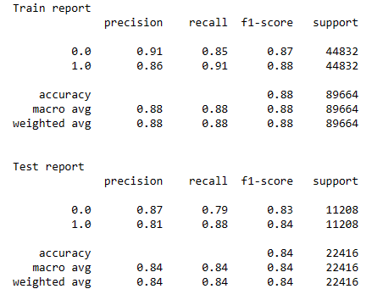
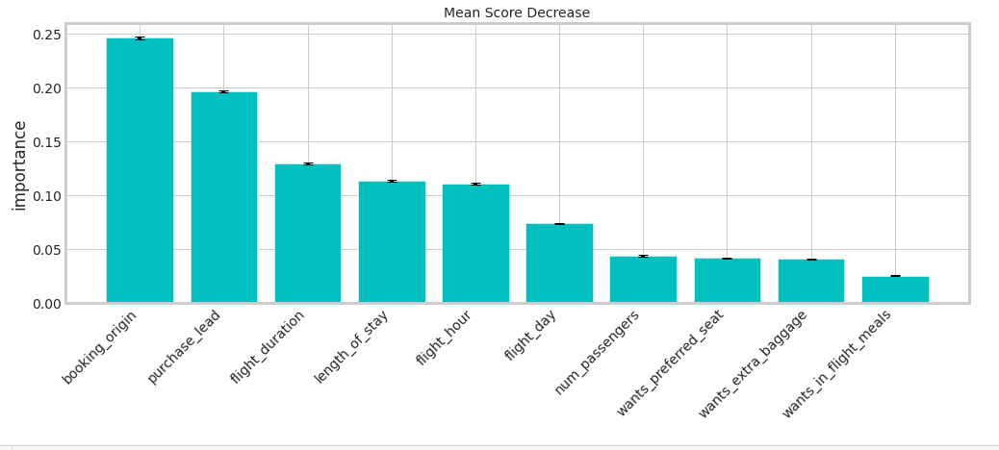
Prediction Model Result
Recall 88%
Chance of predicting true successful bookings.
Precision 84%
Will be predicted as actually completed bookings out of all successfully completed bookings.
Accuracy 84%
of the model predicting successful or incomplete booking is
Chance to predict the bookings that are actually successful.

